Slide 1

Digital speed
innovation challenge
DEMo
Notes:
Hello all, welcome to the final step of the Digital Speed PI6 Innovation Challenge:
the presentation of the outcomes of the 4 teams that have hardly work to make things go faster!

Slide 2

PI#6 Innovation Challenge – Where are we?
Ideation Sessions
Idea submitted
Teams built
Make it real!
2 + 2
29
4
Demo time!
BLR
NCE
Notes:
Many ideas (500 views by 150 people) have been suggested!
Either spontaneously, either from the 4 ideation session hold in NCE and BLR.
29 ideas around Digital Speed have been submitted .
Among all the them the focus has been put on 4 of them.
Heterogenous/Multi skilled and over-motivated teams have worked on during the IP iteration.
No more talks, you will now see the results of their work in 3 min.
Team, Problem fixed, Idea and Deliveries

Slide 3

Agenda
5 min pitch
3 min Q&A
Link My Travel
Progressive Web App – PWA
Improve Interaction Speed
Supersonic Subatomic Pelican

Slide 4
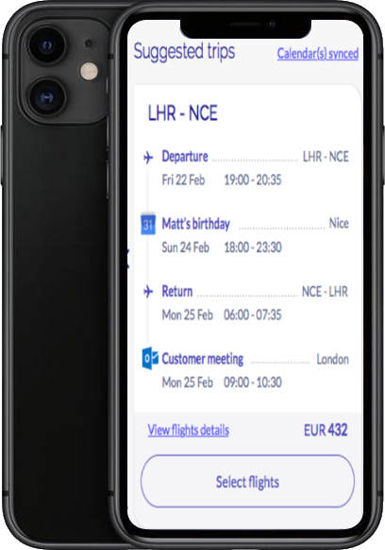
Link my Travel

Slide 5
Link my travel
The team
Frontend Dev - Muthukumar CHINNU
Frontend Dev - Abhishek BURAGOHAIN
PMK - Severine PERCHERON
UX - Maeva CECCHI
Frontend Dev - Rakesh MEMBARAM
Deliveries
Business Highlight
Mockup
Notes:
Solution & PoC on RefX in iOS

Slide 6




Link My Travel
Problem & Solution ideas
Creating a booking can be perceived as long and cumbersome, especially for regular travelers
Need to go through the same steps and enter the same information
May miss some professional or personal constraints
-> leading to a waste of time
Link My Trip to my bookings and searches
Propose a list of trip options based on a combination of bookings history: O&D, day of the week, time, and recent searches on Mobile
-> accelerate the booking creation
-> optimize passenger information accuracy
Link My Trip to my agendas
Propose the right booking options, based on agendas: relevant passenger information should be prefilled, and relevant flight solutions should be displayed in line with agendas
-> accelerate the booking process
-> reduce the risk of ticket change due to some omitted events
Notes:
For non regular travelers it can be stressful as the complexity is error prone (error in the name..).. For these 2 types of population there is a need for support when completing the booking.
This will accelerate the booking creation and at the same time optimize passenger information accuracy.
Let's take, for example a regular traveller, who works in PAR during the week, and need to go home in NCE for the week-end:
The system should directly propose his favorite flight, according to his flight history for the friday evenin
Agenda as an input:On a particular Monday and for the whole week, the traveler has to attend a workshop in London-> The system should display a warning on a mismatch with calendar and then propose him the right flights combination: NCE-PAR-LON-NCE
If the traveler has a personal event up to 7PM on Sunday, the system should remind him that the usual flight at 6PM does not match his constraints, and then propose him relevant alternatives

Slide 7
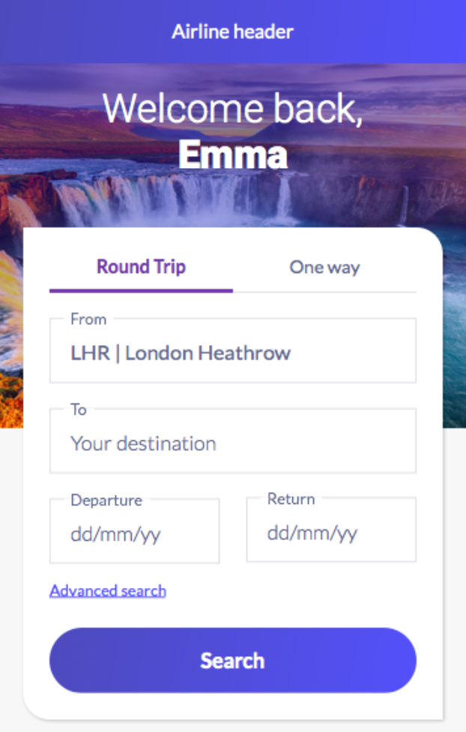
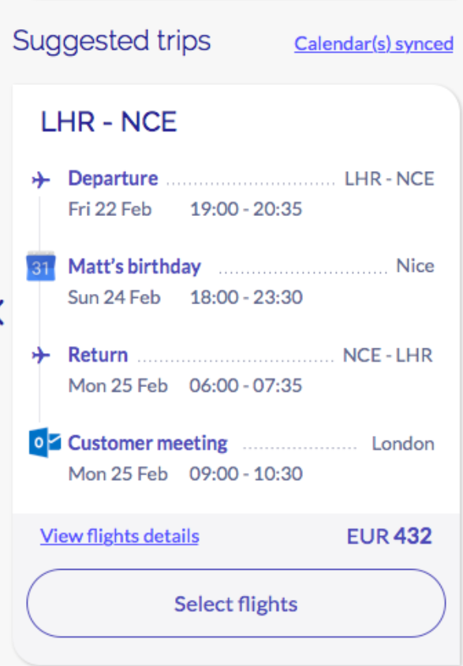
Mockup: Link My Travel to my agendas

Slide 8
Link My Travel
iOS – JS bridge
iOS
RefX
Booking
History
Search
Suggested
Trips
Availability
Pax
Payment
Confirmation
Advanced
Search
Offer 1
Offer 2
Offer n
Read Travel History
Fetch meeting and appointment
Redux Store
Calendar
Search History
Booking History

Slide 9

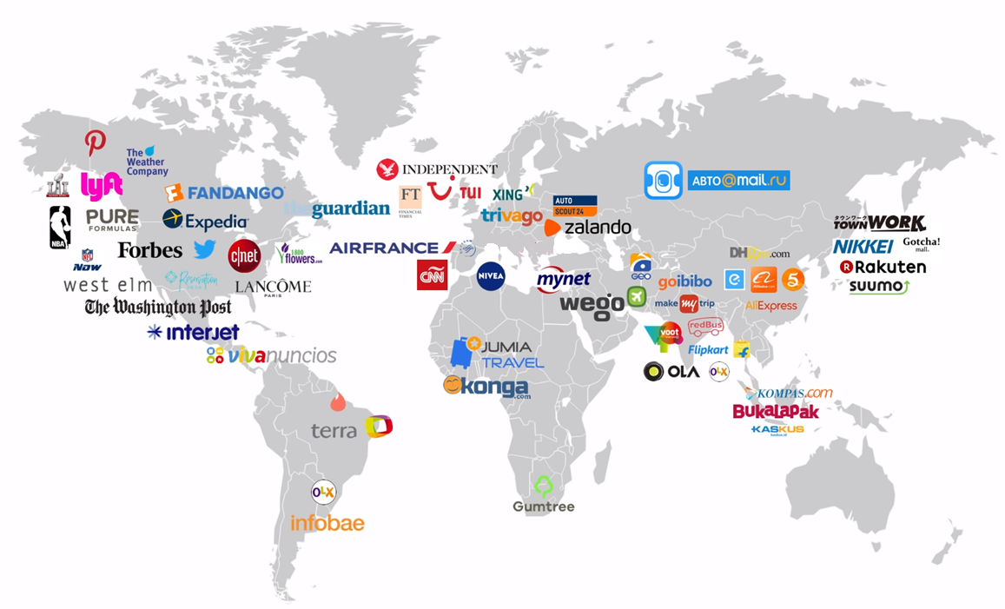
Progressive Web App
Shrey RUPANI & Julien ARAMINO
With Jean MOUYADE support

Slide 10
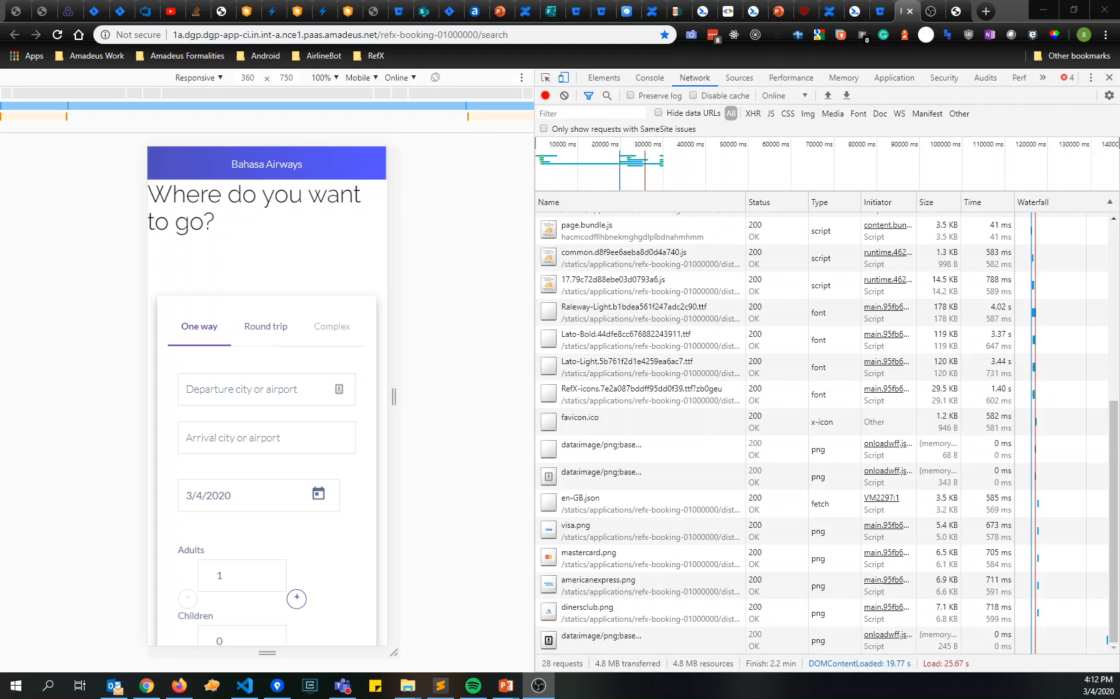
The problem
Is performance only possible in native?
Notes:
When customers want to access airline services, they are given the choice between the web and the app.
And they are going to go one way or the other depending on criteria.
Web apps have reach, but native apps have capabilities such as...

Slide 11
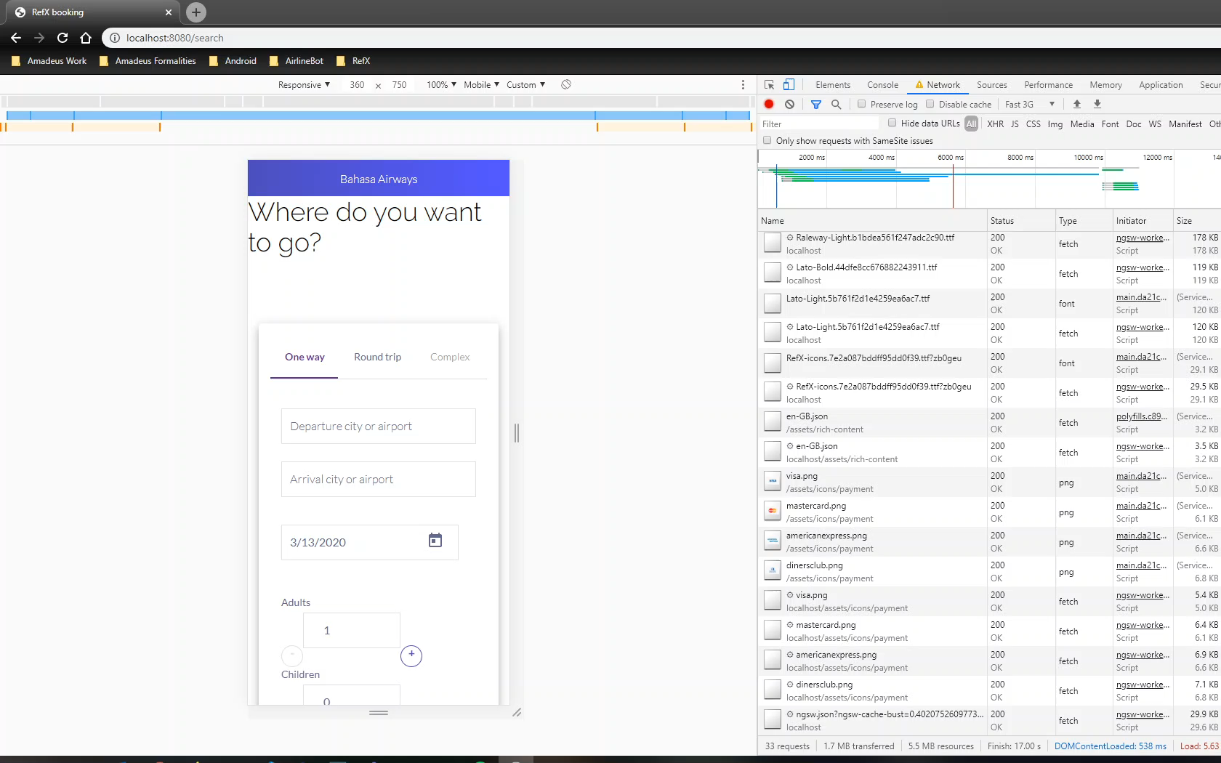
The solution
Highly performant downloadable web-apps!
Notes:
When customers want to access airline services, they are given the choice between the web and the app.
And they are going to go one way or the other depending on criteria.
Web apps have reach, but native apps have capabilities such as...

Slide 12
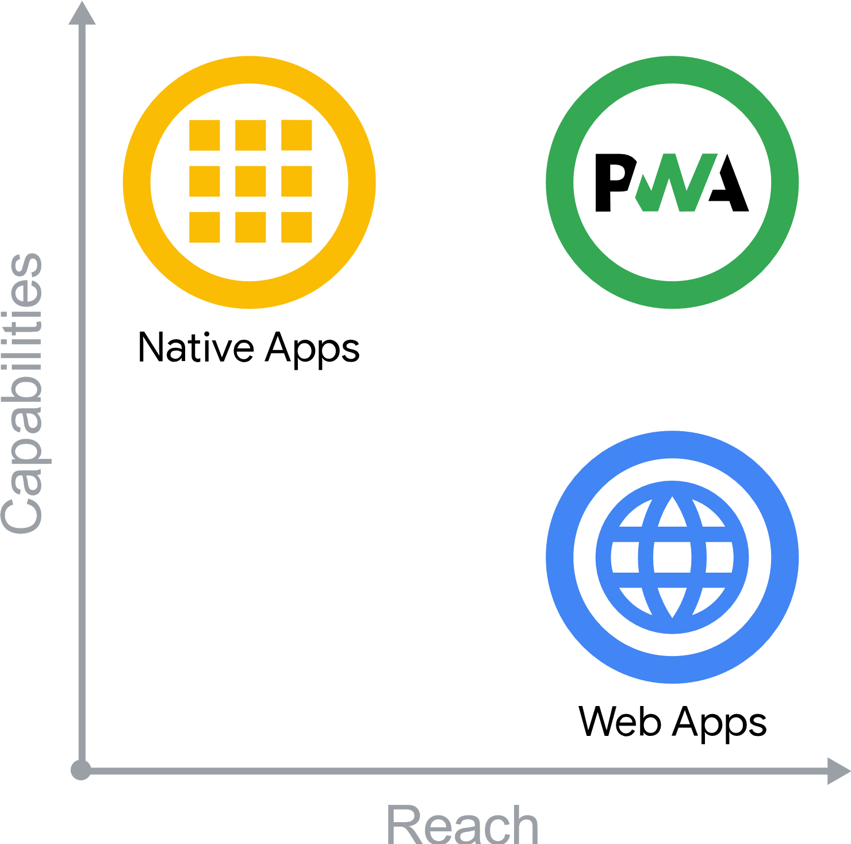
Why should we switch?
Highly performant Reference Experience
Skip app store step to install airline app
Evergreen app and web -> no annoying updates
Offline support
Single code base for all channels
Standalone experience
Notes:
Progressive Web Apps (PWA) are built and enhanced with modern APIs to deliver native-like capabilities, reliability, and installability while reaching anyone, anywhere, on any device with a single codebase.

Slide 13
What’s now?
Purely UX, manifest file for bookmark
Greatly enhances performance
Statics loaded by service worker
Some offline support
Determine perceived user response time

Slide 14
What’s next?
Installable PWA
Intelligent prompt to nudge user to install
Snackbar that shows network connectivity
Push notifications
Maximal offline support
Semantic versioning
Shared data
Notes:
Installable PWA -> Any device, low size
Intelligent prompts -> Julien will speak about this
Snackbar or toast -> Will alert the user that they are not connected to the internet
Push notifications -> Increase user retention. Get user before they use a different means of travel.
Maximal offline support -> Till payment or order retrieve example
Semantic versioning -> Will create update structure and make the PWA robust
Shared data -> Temporary items added to the cart will show in other channels etc.

Slide 15
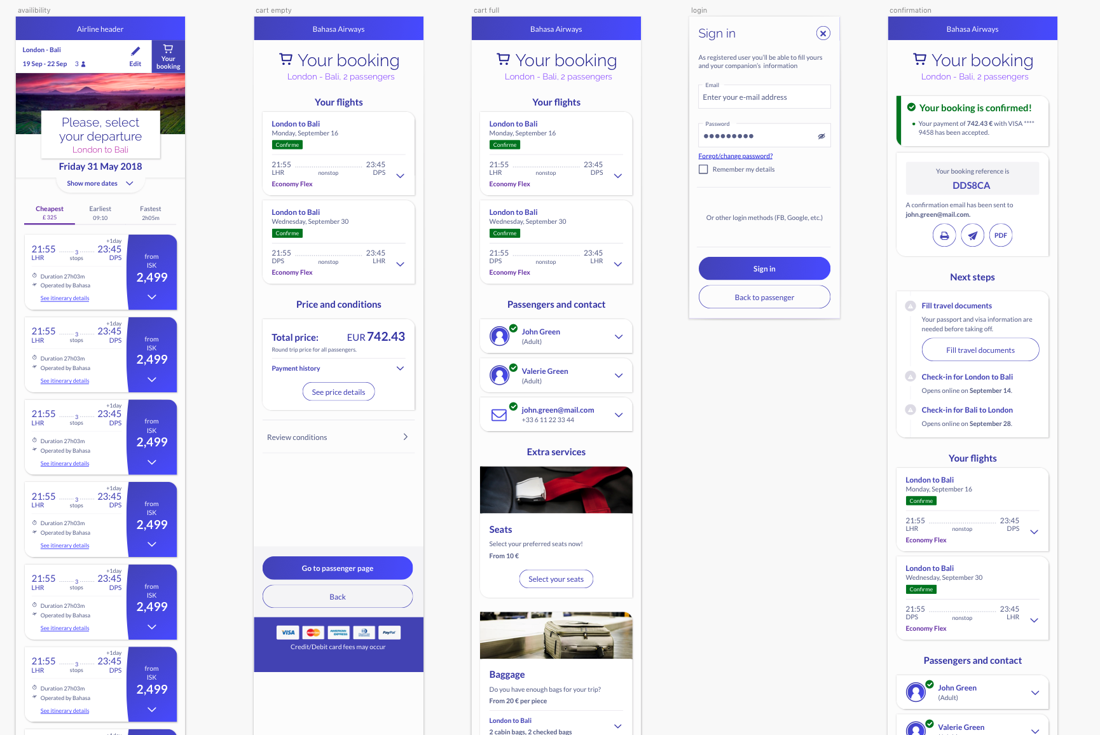
When user is engaged?
UX Study
When to prompt for installation?
After search ?
On cart
Before sign in
On confirmation
How to prompt?
Banner
Card
Bottom sheet
Button in header
…

Slide 16
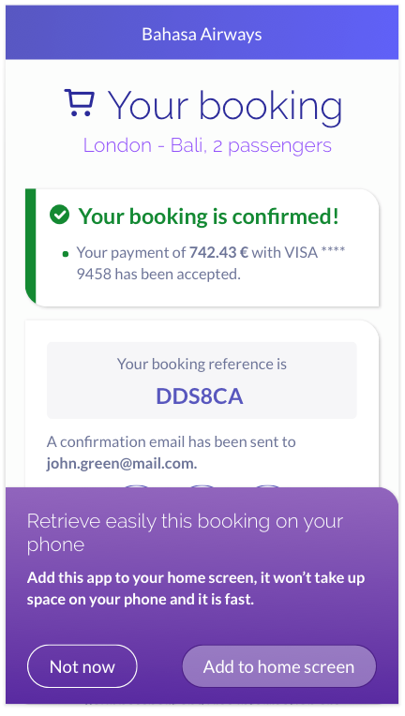
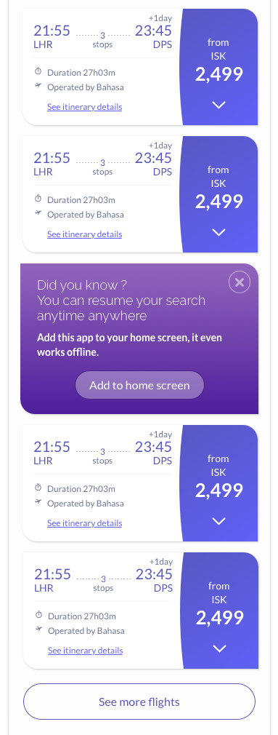
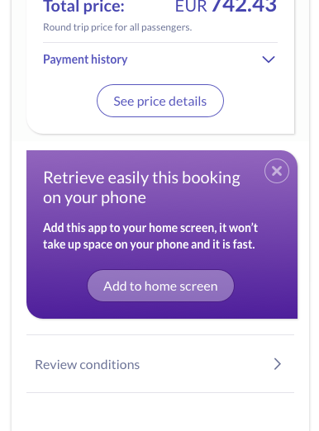
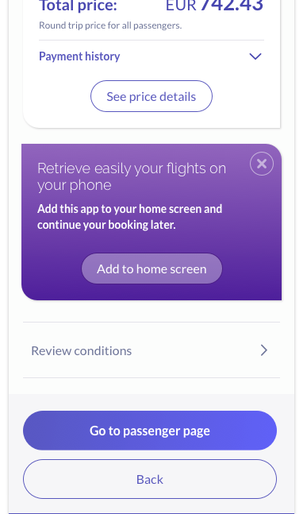
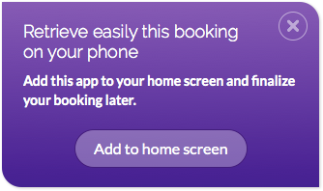
UX Study (2)
Confirmation
bottom sheet ...
Sign-in
Banner
It should not appear during sign-in
But it can appear
after
Button
Key message:
Retrieve / save booking info easily
Availability (return)
Key message:
Continue your search / works offline
… Confirmation
card
Cart teaser
(Incomplete)
Key message:
Continue your booking later where you want, when you want
It appear 5 second after page load: user has to understand first the booking confirmation
Cart teaser
(Complete)
Key message:
Pay later

Slide 17

Improve Interaction Speed
Notes:
Move redux logic into Javascript Workers

Slide 18
Improve Interaction Speed
The team
Stefan SEEGER mentored by Guilherme VIEIRA SCHWADE
The problem
All Javascript web applications are running the code in the one main thread. This means that big data computations are blocking UI interactions.
The idea
Move the RefX store logic into WebWorkers to parallelize them
Challenge
Sharing data across WebWorkers creates overhead – It is going to be exciting!
Delivery
PoC on RefX Availability to assess the time to interaction gains; Or investigation

Slide 19
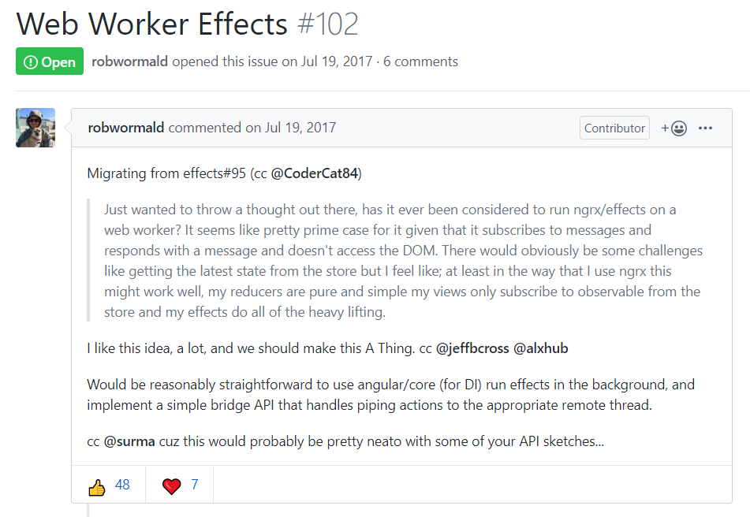
Improve Interaction Speed
https://github.com/ngrx/platform/issues/102
https://github.com/ngrx/platform/issues/102

Slide 20

Supersonic Subatomic Pelican

Slide 21



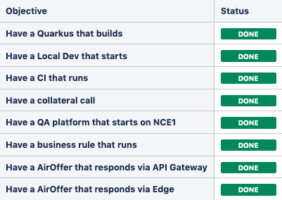
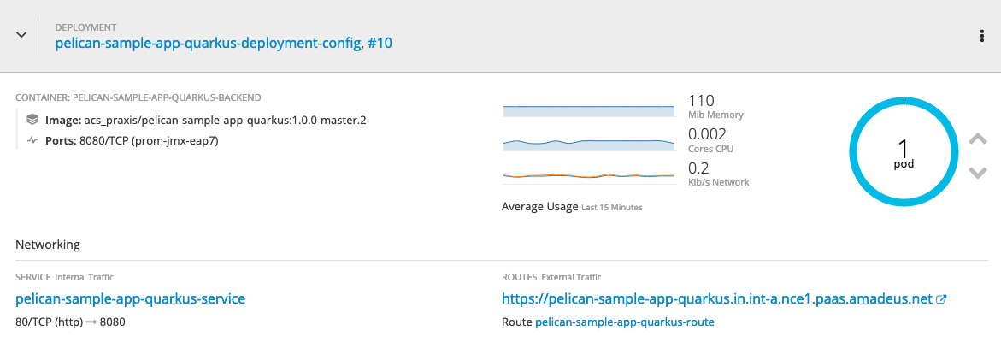
Supersonic Subatomic Pelican
Team | Sanka SAMARANAYAKE / Matteo CASALINO / Fabrice PIPART
Problem | Pelican aims at revisiting the development experience and the operability of our Java backends in the Cloud. But it is based on an application server that takes minutes to start and eat tons of RAM.
Idea | Prototype the usage of Quarkus to accelerate all phases of the lifecycle of Pelican. From Dev to Prod. Quarkus is lighweight, Cloud native, starts in a few seconds, consumes a minimal amount of RAM and is designed for developer joy.
Delivery
…

Slide 22

THANK you! AND…

Slide 23


GET
READY
FOR
THE
NEXT…
Notes:
PLANNING EVENT

